Slide 1

CS 225 Project Dungeon Crawl
Jaxson Mitchell
Zoe MOrAwek
Thomas Meyers

Slide 2
Overview

Slide 3
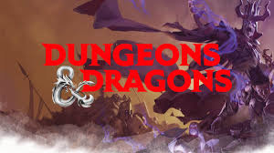
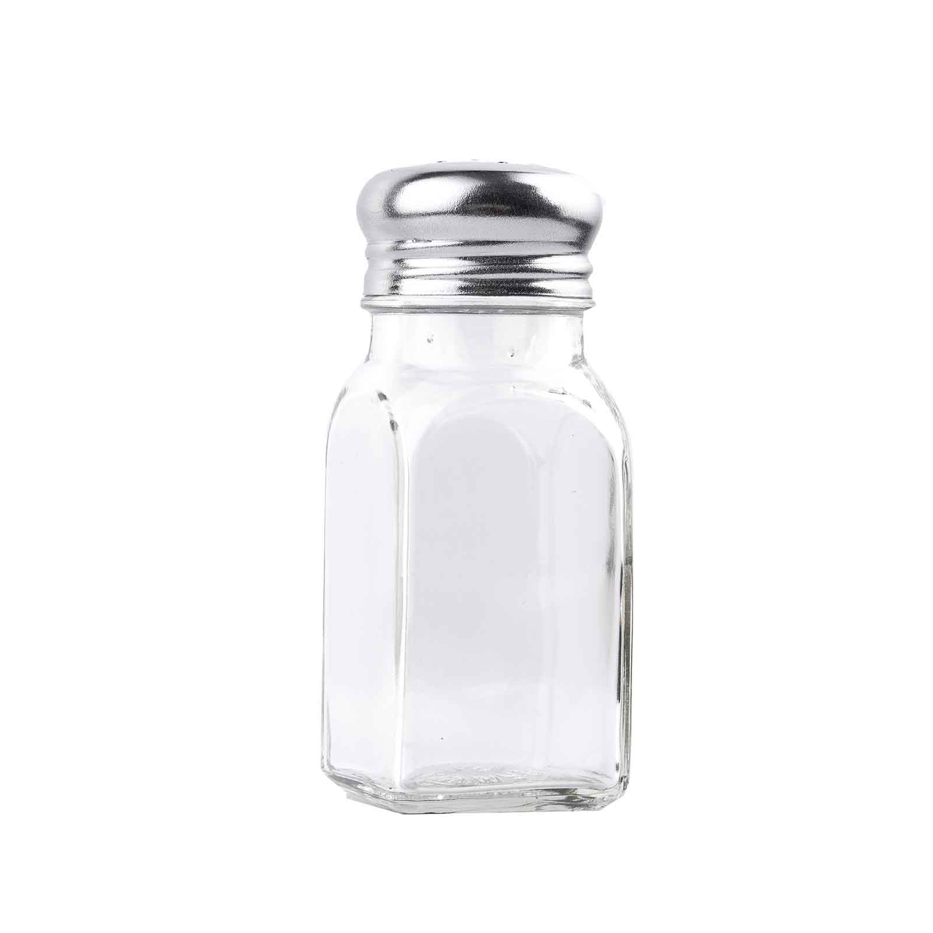
Overview: What is the project?
The goal of the project is to create a text-based campaign where
Four brave adventurers struggle to find the ever elusive salt-shaker!
The adventure was based off Dungeons and Dragons
Adventurers have multiple classes (Knight, Wizard, etc.)
There are multiple different types of enemies.

Slide 4
Overview: The rubric
The code must satisfy the following:

Slide 5
Overview: Our Game
What did we make

Slide 6
Implementation and Diagrams

Slide 7
Implementation: Adventurer UML Diagram

Slide 8
Implementation: Monster UML Diagram

Slide 9
Implementation Battles

Slide 10
The code itself

Slide 11
1 part of the rubric

